Slide 1
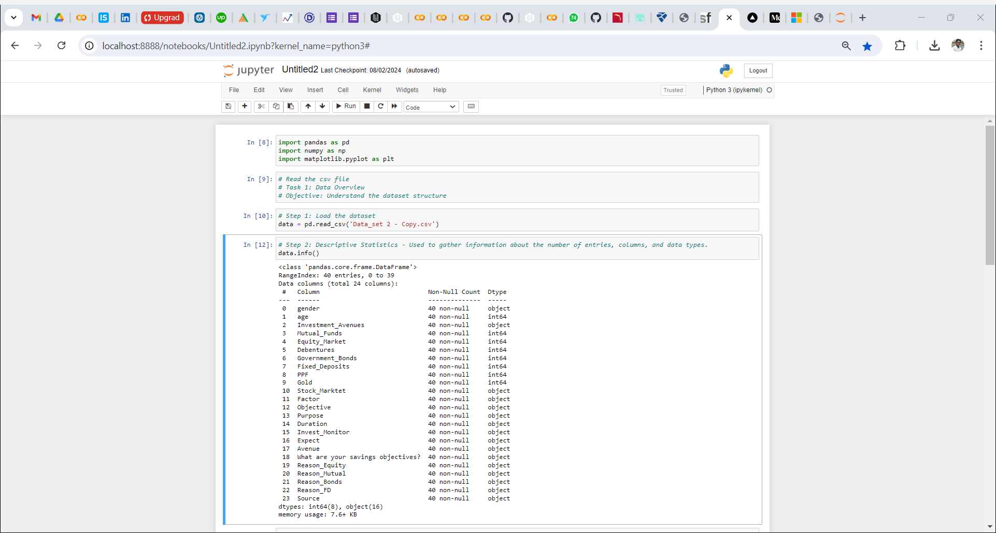
Task 1: Data Overview
Objective: Understand the dataset structure

